Slide 1
Cross-shore suspended sediment transport in the upper shoreface
Marc Pezerat^{1*}, Xavier Bertin²
Service Hydrographique et Océanographique de la Marine (SHOM), Brest, France
marc.pezerat@shom.fr
UMR 7266 LIENSs, CNRS – La Rochelle Université, La Rochelle, France

Slide 2
Outline of the presentation
2
Zonation of the shoreface and suspended sediment transport driving mechnisms
Results from the field campaign Saint-Trojan 2021 (macro-tidal & low-sloping shoreface)
Suspended sediment transport by short waves
Suspended sediment transport by IG waves
Based on « Cross-shore suspended sediment transport in a macro-tidal and low-slopping upper shoreface », ESPL, 2023.

Slide 3
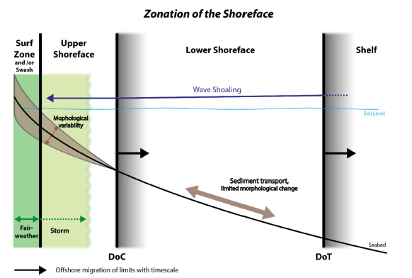
Zonation of the shoreface
3
Shoreface transitionning between the surf zone and the shelf plays a crucial role in morphological evolution of adjacent shorelines
A common distinction upper shoreface / lower shoreface based on observed morphological variability
In macro-tidal and wave-exposed coastal region, the upper shoreface morphodynamics is strongly affected by the extension of the surf zone
Hamon-Kerivel et al. (2020)

Slide 4
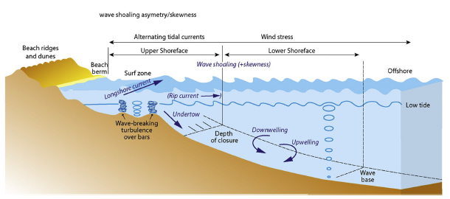
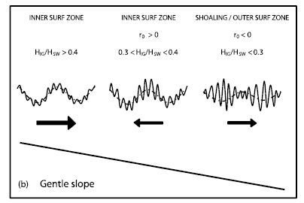
Suspended sediment transport driving mechanisms
4
Fine sandy sediments are more likely transported in suspension across wave exposed nearshore area (u* > Ws)
Suspended sediment transport is forced by both oscillatory wave motions and steady currents
The transport at short wave frequencies is related to the wave shape, determined by a certain degree of skewness and asymmetry
IG waves also contribute to suspended sediment transport depending on the IG/G energy ratio and IG wave propagation regime.
Importance of the wave-driven mean circulation (most notably the undertow) well identified on beaches
Anthony and Aagard (2020)
de Bakker et al. (2016)

Slide 5
Remaining questions
5
What about beyond the inner surf zone ?
Very few measurements in relatively deep water (beyond the inter-tidal area), mostly due to instrumentation difficulties
What are the differences in the transport regime between storm events and fair weather conditions ?
What are the relative contributions of the different driving processes (oscillatory motions vs steady currents) to suspended sediment transport ?
What are the mechanisms observed ?

Slide 6
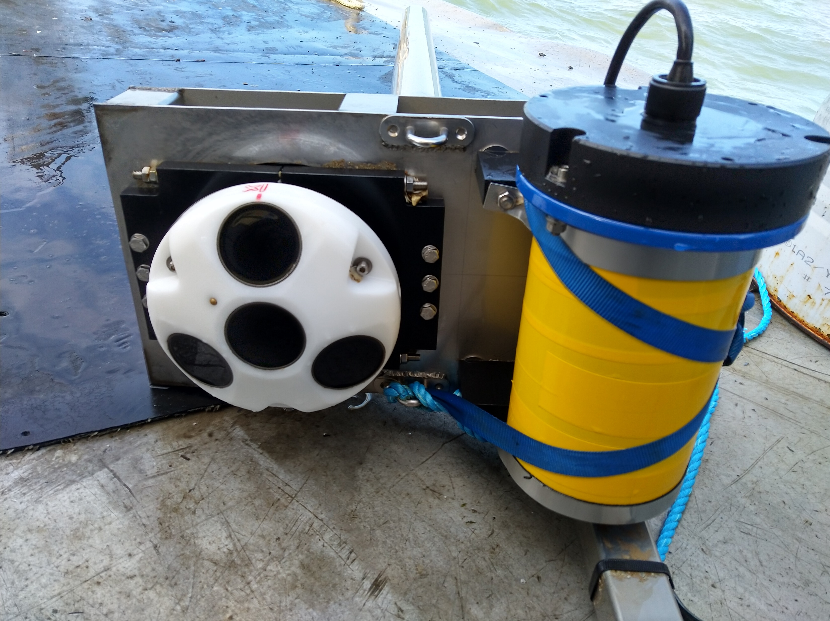
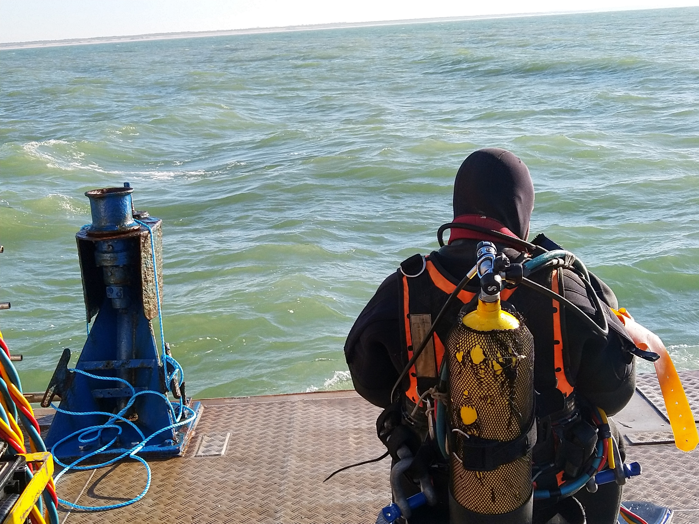
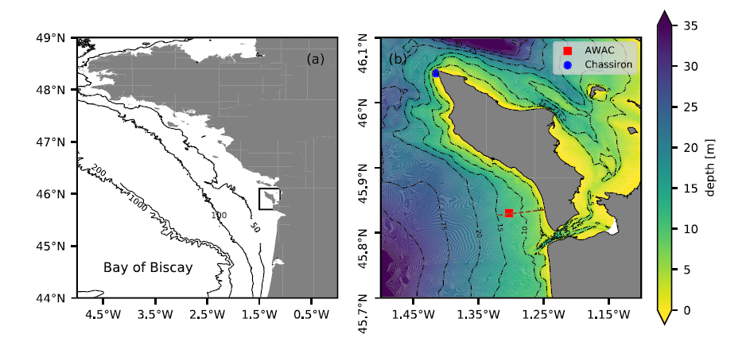
The field campaign Saint-Trojan 2021 (ST2021)
6
Thanks !
Campbell
Tides are semi-diurnal. Tidal range [1,5 m, 5.5m]
Low-sloping shoreface (isobath 20 m 10km offshore)
Shore normal incidence of waves
Storm events (6 m Hm0) and fair-weather conditions
 | Current cycle (10 min) | Wave cycle (2 Hz / 20 min)
AWAC | 10 min-averaged velocity profile measurements | Velocity at a fixed location and bottom pressure measurements
OBS |  | SSC

Slide 7
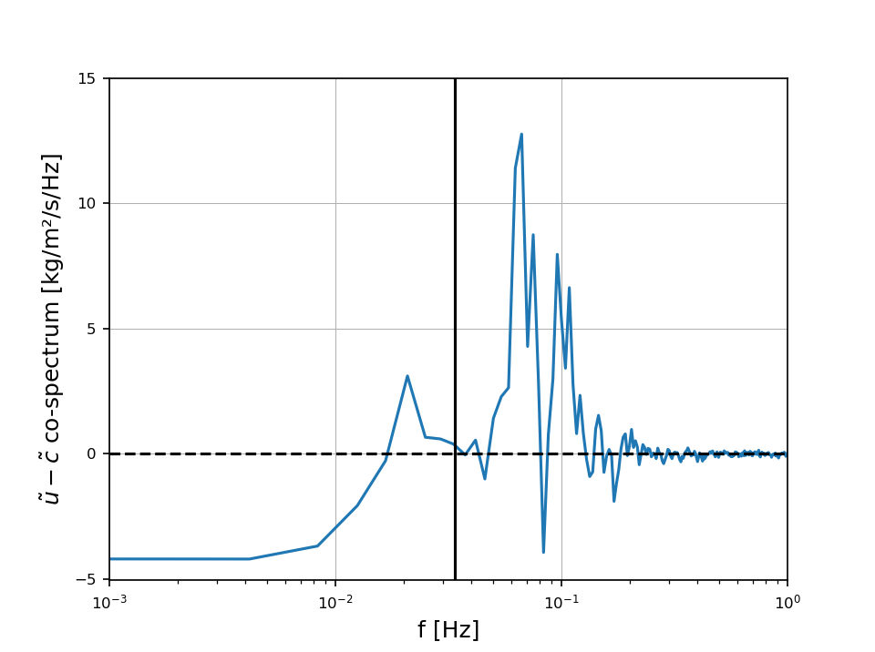
Data processing
7
FFT (5 hanning-windowed segments with 50% overlap / 10 DOF)
Short wave free surface elevation
Elevation density spectra $E(f)$
$H_{m0}^{G/IG}$, $T_{pc}$
Pressure measurements
TFM ($f_{c}=0,2 Hz$)
$∫$with $f_{IG/G}=\frac{1}{2T_{pc}}$
Time-averaged suspended sediment flux (e.g. Jaffe et al. 1985):
$$u= \overline{u}+\tilde{u}$$
$$c= \overline{c}+\tilde{c}$$
$$q= \overline{uc}= \overline{u}\overline{c}+ \overline{\tilde{u}\tilde{c}}$$
onshore
IG band
G band
$q_{osc}$ or « flux coupling » measures the contribution from oscillating dynamics through the correlation between the fluctuations of velocity and concentration
$q_{mean}$ is the transport forced by the mean current i.e. tidal current and wave drivean return current
offshore

Slide 8
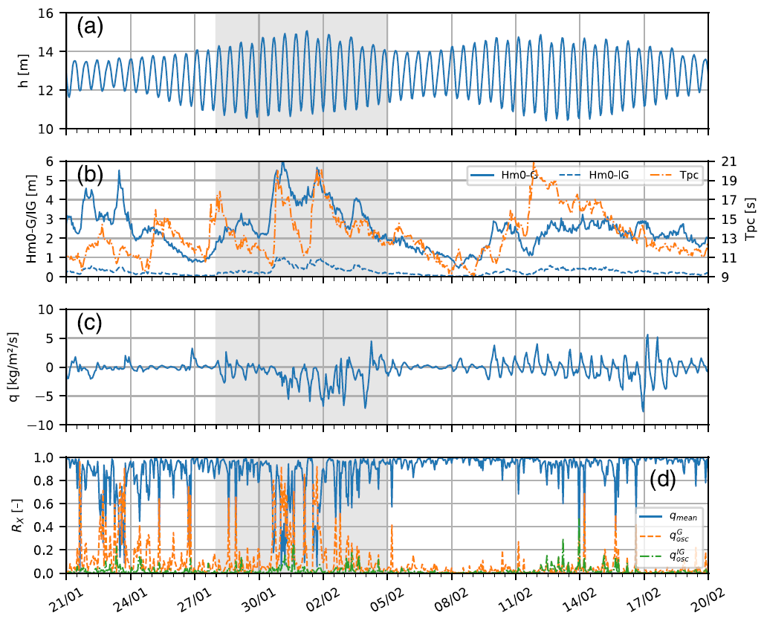
Results
8
$q_{mean}$ dominates with a strong tidal modulation of $q$ especially during spring tides
Strong contribution of the wave-driven return current during the main storm episode (cf. Pezerat et al. 2022 JGR) resulting in offshore directed transport
Predominant contribution of the flux coupling for some burst especially under energetic conditions
Prevailing contribution of the flux coupling in the G band associated with a weak local ratio ${H_{m0}^{IG}}/{H_{m0}^{G}}∼10 \%$

Slide 9
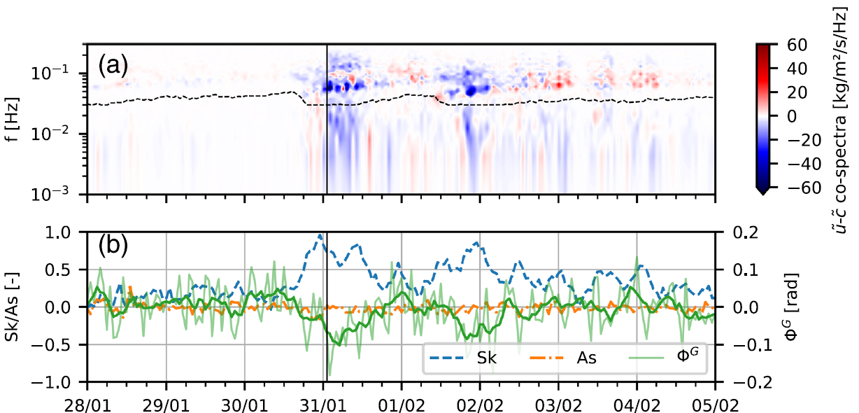
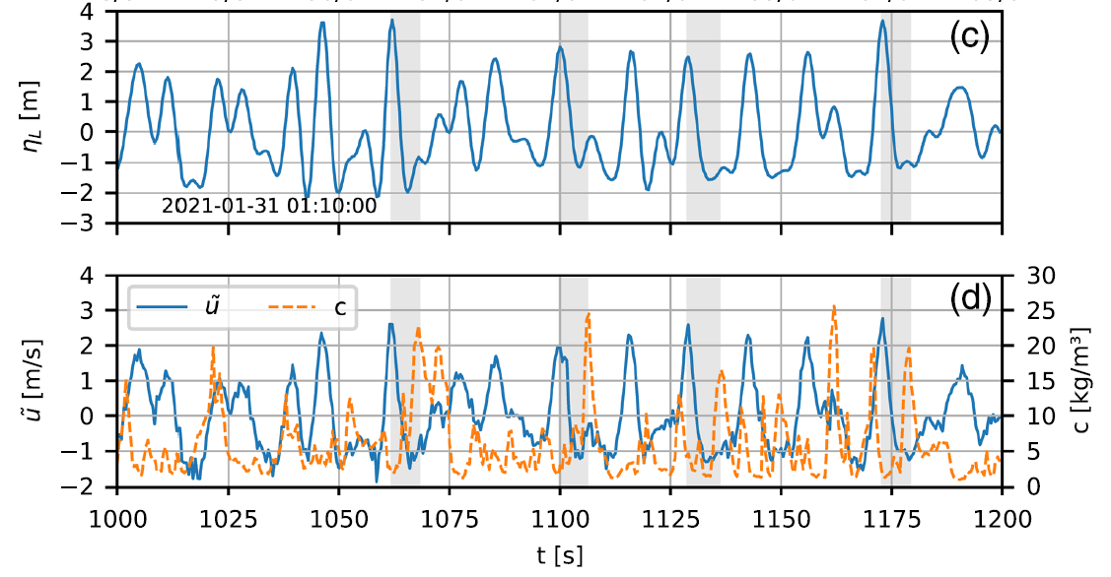
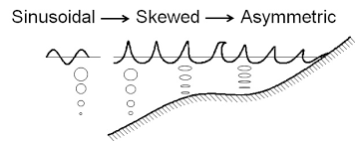
Suspended sediment transport by short waves
9
Crest-to-trough phase lag (e.g. Grasso et al. 2011)
Readily estimated from cross-spectral analysis between $\tilde{u}$ and $\tilde{c}$
legi.grenoble-inp.fr

Slide 10
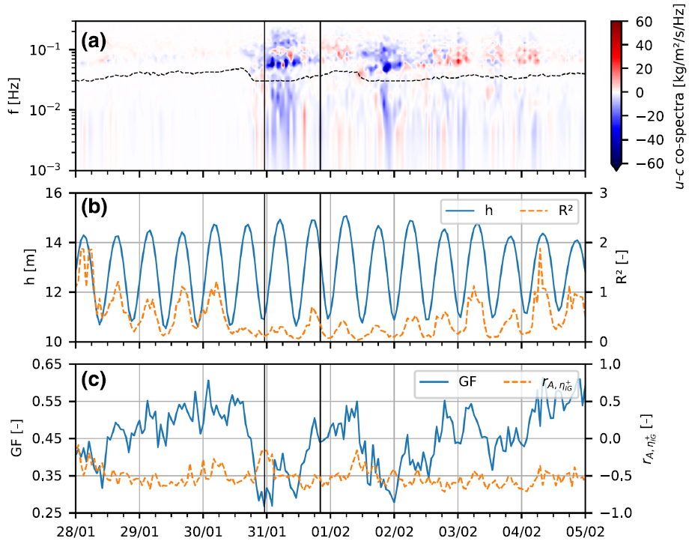
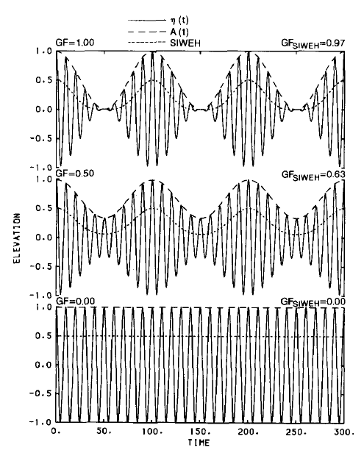
Suspended sediment transport by IG waves
10
Separation of shoreward / seaward propagating IG waves:
Strong tidal modulation of R² under fair weather conditions
High value of R² at high tide explained by a steeper slope in the beach upper part
Lower values of R² during energetic conditions explained by a decrease of wave energy between the sensor and the shoreline associated with non-linear energy transfers toward the G band (Bertin et al., 2018)
Illustration of GF and the envelope of short wave elevation A
(List, 1991)

Slide 11
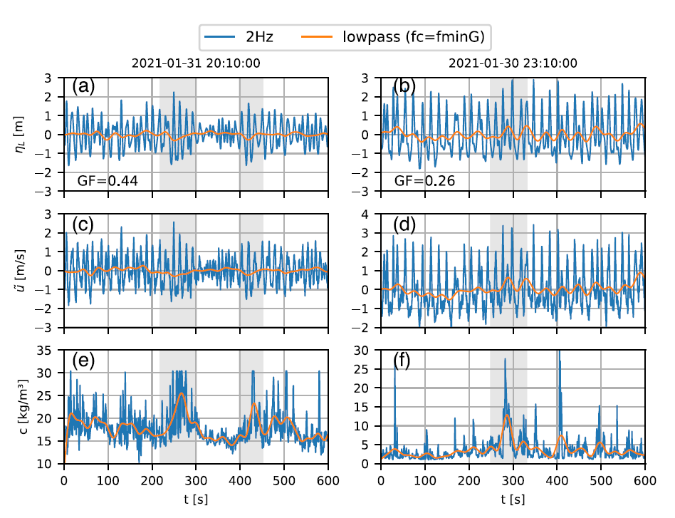
Suspended sediment transport by IG waves
11

Slide 12
Conclusion and perspectives
12
Dominant contribution of steady currents to suspended sediment transport:
Tidal currents modulate the sediment flux under fair weather conditions
The undertow is shown to force an offshore-directed transport under storm conditions
Key contribution of short-wave motion under energetic conditions globally inducing an offshore directed transport resulting from a crest-to-trough phase lag effect
Second order contribution of IG waves with a transport mostly offshore directed associated with shoreward propagating IG waves bound to short-wave group. Good agreement with the conceptual model of de Bakker et al. (2016)
Link with erosion trend ?
200 m
Chaumillon and Flament (2021)

Slide 13
Thank you for your attention

