Slide 1
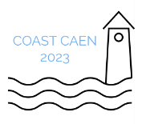
Increasing biological knowledge of the Ruditapes philippinarum population from Arcachon Bay (SW France) for a better sustainable management
N. Caill-Milly¹, F. Sanchez¹, N. Bru², X. de Montaudouin³, T. Briaudeau⁴
¹ Ifremer, Anglet, France
² University of Pau & Pays Adour, Anglet, France
³ University of Bordeaux, Arcachon, France
⁴ University of the Basque Country, Plentzia, Spain
COAST Forum – 24-27th OCTOBER 2023 – CAEN (FRANCE)

Slide 2
MCRS vs reproduction
MCRS vs others
Discussion/Conclusion
Context and issues
2

Slide 3
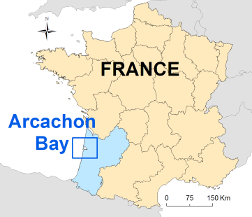
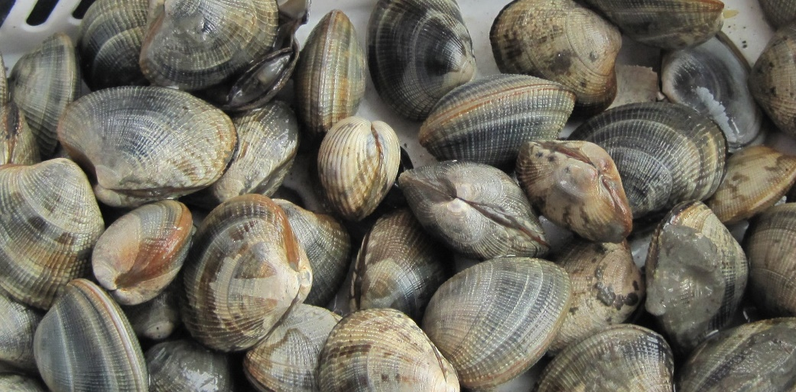
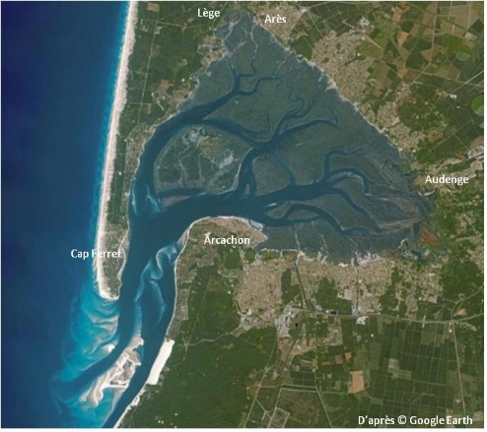
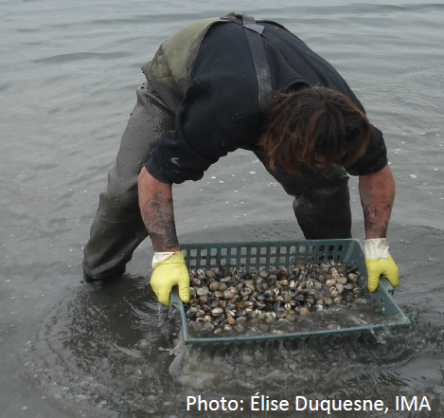
MCRS vs reproduction
MCRS vs others
Discussion/Conclusion
Context and issues
Localization / Species / Fisheries
Lagoon
intertidal mud flats, channels
© Ifremer
Manila clam (Ruditapes philippinarum)
Exploitation at low tide, by hand
3

Slide 4
MCRS vs reproduction
MCRS vs others
Discussion/Conclusion
Context and issues
Regulatory framework
European | National | Local
Capture length for Atlantic: 35 mm currently (Reg CE n°40/2008) | Mandatory equirement to possess a national fishing license since 2010 (by Decree n° 2010-1653 December 28, 2010) | Local regulations established by the local Committee of Marine Fisheries and Aquaculture (number of licenses, fishing time limits, closed areas, catch quotas...)
Established by EU commission | Awarded by the departmental prefect for 12 months | Established by prefectoral order
Upon a professional request, the DPMA asked for an expertise regarding the potential impacts on the local stock that may have a modification of the Manila clam Minimum Conservation Reference Size (MCRS) for Arcachon Bay
How to fix a MCRS?
The MCRS is a size limit established to protect juveniles.
Primarily set according to the size at which 50% of the population reaches maturity (SL₅₀), to allow individuals to mature and reproduce at least once before being caught.
However, the MCRS cannot be determined solely on the basis of demographic structure. It usually integrates biological and economical parameters such as reproductive strategies, stock status, market size, productivity optimization, among others.

Slide 5
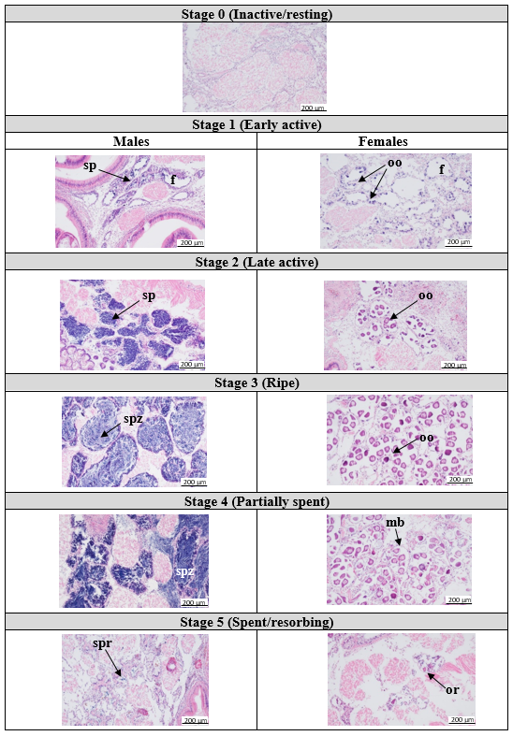
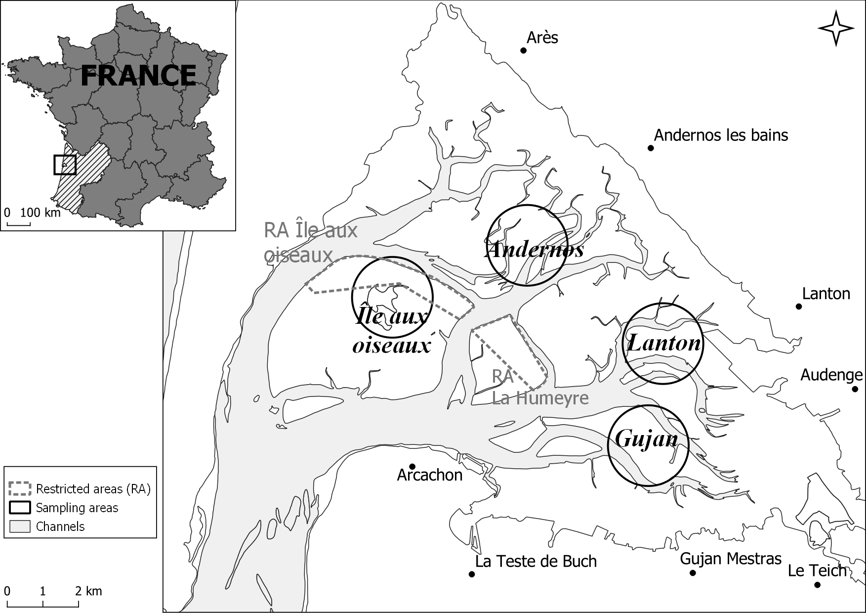
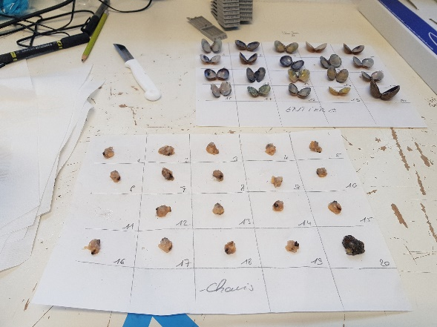
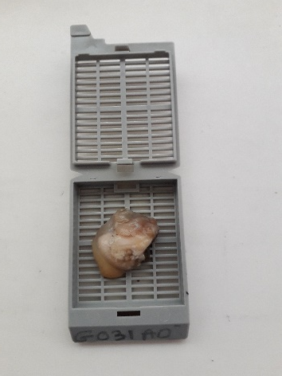
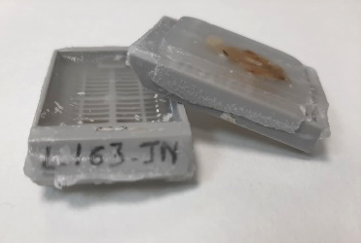
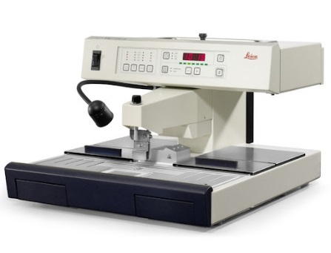
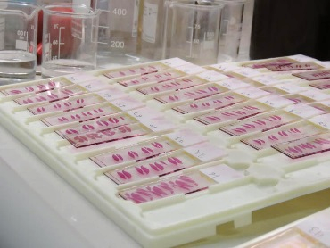
MCRS vs reproduction
MCRS vs others
Discussion/Conclusion
Context and issues
SL₅₀ assessment – Data sampling and preparation
June to August 2021
4 sites sampled within the Bay (various environmental conditions)
1420 analyzed clams
Measures and histological preparations
Gonad maturity stages using a 6-stages nomenclature
According to Drummond et al. (2006) and Moura et al. (2018)
© Shom - Ifremer/Lissardy

Slide 6
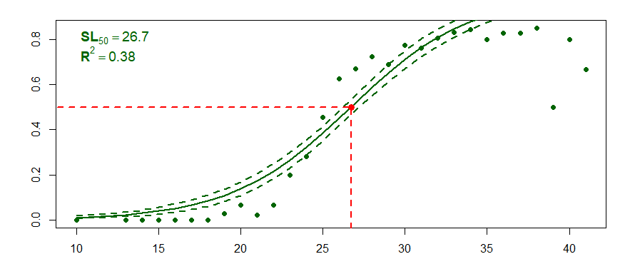
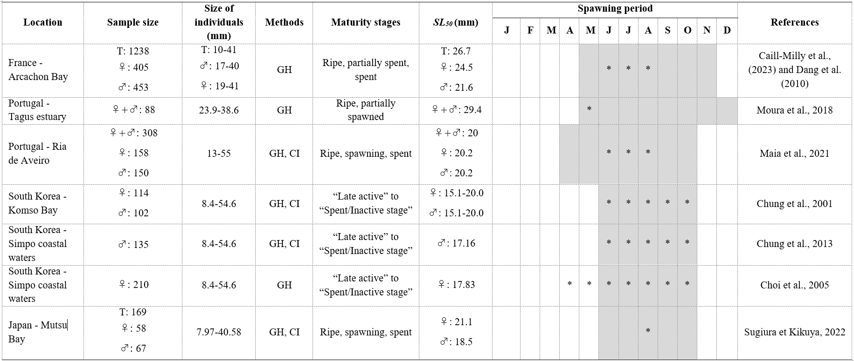
MCRS vs reproduction
MCRS vs others
Discussion/Conclusion
Context and issues
SL₅₀ assessment
- Results
1238 clams with determined stages
SL₅₀ = 26.7 mm
♀ SL₅₀ = 24.5 mm
♂ SL₅₀ = 21.6 mm
The findings (SL₅₀ and reproduction phenology in Arcachon Bay are within the range of what is observed elsewhere.
Notes:
Vérification faite pour la Corée. Il s’agit bien du même site.

Slide 7
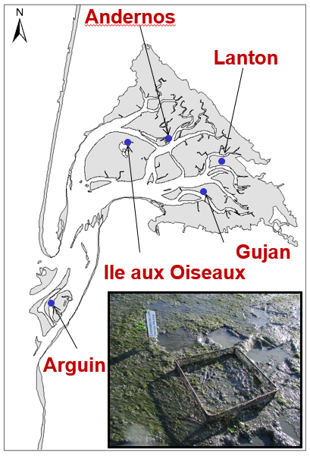
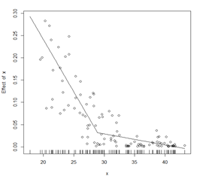
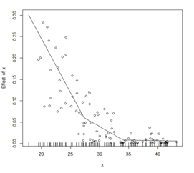
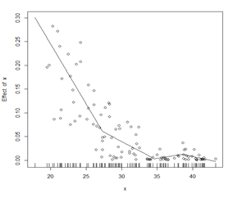
MCRS vs reproduction
MCRS vs others
Discussion/Conclusion
Context and issues
Growth modeling
- Data sampling and analysis
2 years survey (2005-2007)
Enclosures at different hypsometric levels (Q1 to Q4) in 5 sites within the Bay and at its entry
Clams marked individually and recaptured
To study growth dynamics
Along time | Rate of change in size according to initial length
Von Bertalanffy growth parameters Results not shown here | Detection of slowdown in the average rate of change using piecewise linear regression models (from 1 to 3 breaks), significance of the slopes differing from 0 and selection with AICc See next
+
Example of modeling with 1, 2 or 3 disruptions

Slide 8
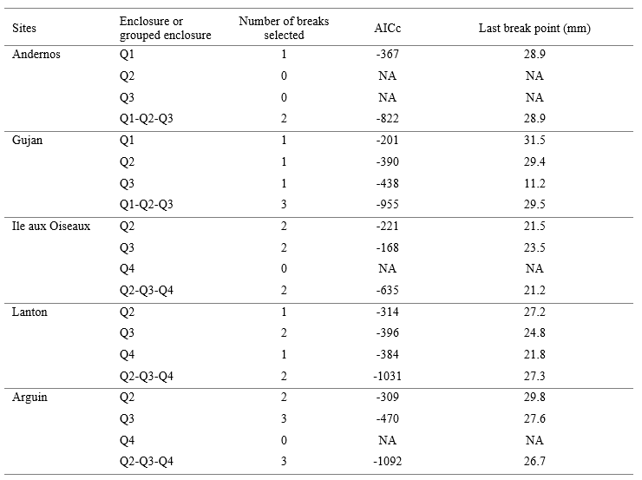
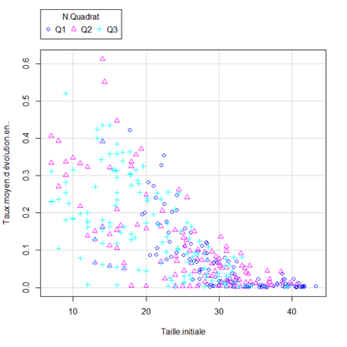
MCRS vs reproduction
MCRS vs others
Discussion/Conclusion
Context and issues
Growth modeling
- Results
Rate of change in size according to initial length
The greatest length at which a slowdown in growth was observed is 28.9 mm, 31.5 mm, 23.5 mm and 27.3 mm for Andernos, Gujan, Ile aux Oiseaux and Lanton, respectively.
For the oceanic site, it was 29.8 mm.
Average rate of change in size (in %)
Example Andernos site – 3 enclosures (Q1 to Q3)

Slide 9
MCRS vs reproduction
MCRS vs others
Discussion/Conclusion
Context and issues
Regarding production
- Methodology
Biomass evolution assessed using a simulated cohort of 1,000 individuals with an initial 30-mm shell length (a size close to that at which a growth slowdown was determined)
Cohort dynamics, in the absence of fishing, using growth and mortality parameters specifically established for the Arcachon Bay.
Two precisions defining two methods:
Method 1: based on the percentage mortality estimates as a function of length (for individuals between 30.0 and 34.9 mm, the monthly mortality rate applied was 3.9%; for individuals between 35 and 40 mm, the rate applied was 1.8%). Percentages common to all enclosures.
Method 2: based on the natural mortality coefficients estimated for individuals between 20 and 40 mm in size from enclosure experiments. Coefficients specific to each enclosure.
Estimation of the size at which the natural mortality offsets the weight growth.
This was done for each site and each enclosure.

Slide 10
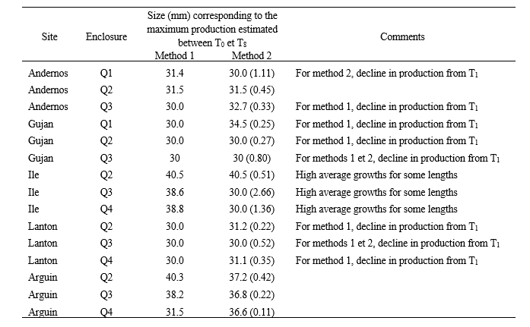
MCRS vs reproduction
MCRS vs others
Discussion/Conclusion
Context and issues
Regarding production
- Results
With the first method and for the intra-lagoon enclosures, the maximum biomass over the two simulated years was obtained at an average size of 32.6 mm.
With the second method, this size was 31.8 mm.
For the oceanic site Arguin, the average size for the maximum production were 36.7 and 36.8 mm for the first and second method, respectively.
=> From 30 mm, the best compromise between individual growth and natural mortality is for a ca. a 32-mm shell length for sites inside the Bay and 37 mm for the banc d’Arguin.

Slide 11
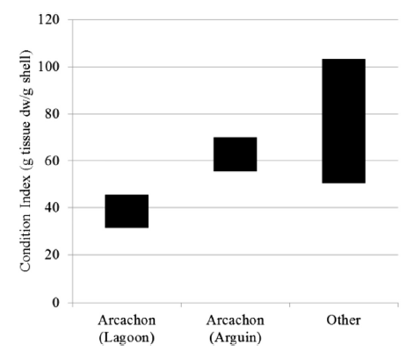
MCRS vs reproduction
MCRS vs others
Discussion/Conclusion
Context and issues
Regarding physiological status
The physiological status assessed by the CI is particularly low (mean CI 32-49 ‰) by comparison with other sites in Europe or elsewhere in the world (51-103 ‰), meaning a poor physiological status for Manila clam inside the Bay
Mean range of condition index in Arcachon lagoon (main habitat of the Asari clam), Arguin (out the lagoon) and other sites in France, Ireland, Italy, Portugal and Korea(source : X. de Montaudouin et al., 2016)
Notes:
Xavier a peut être un autre graphe à proposer. Je l’ai pris de sa publication de 2016.

Slide 12
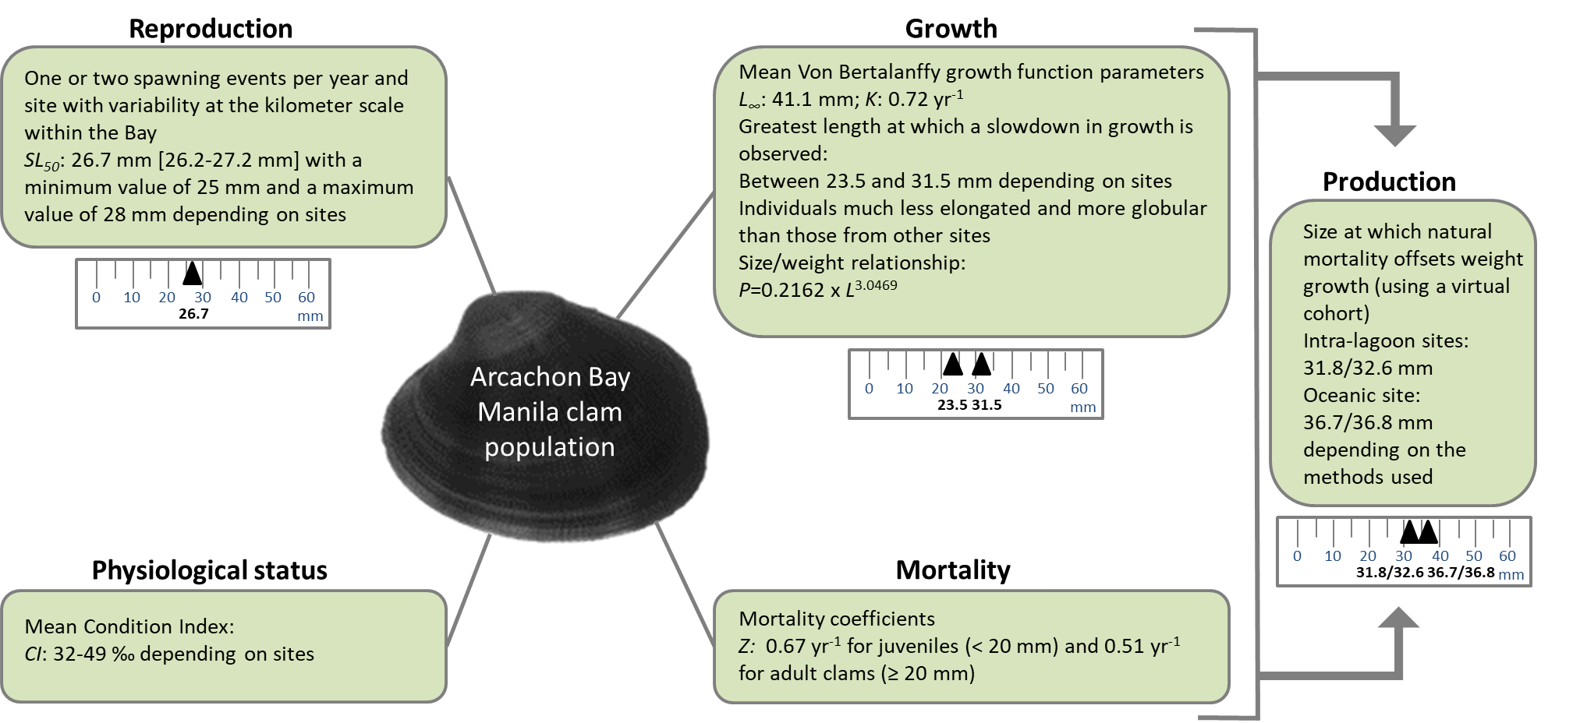
MCRS vs reproduction
MCRS vs others
Discussion/Conclusion
Context and issues
Results synthesis
Biological information needed to be taken into account to revise the MCRS of Manila clam in Arcachon Bay have been provided to the European commission.
12

Slide 13
MCRS vs reproduction
MCRS vs others
Discussion/Conclusion
Context and issues
The present results complete the knowledge on the Manila clam population from the Arcachon Bay; they are necessary for the STECF to evaluate the suitability of a new MCRS.
Some remaining warning points include juveniles and adults protection (as required by the Technical Measures Regulation – Art. 18).
Setting a specific MCRS at 32 mm for Arcachon Bay cannot be considered without the joint application of other adaptive management strategies and measures. Local regulation includes protected areas and measures to limit fishing efforts (e.g. number of licenses, authorized catch periods, quotas, etc.).
Upon a potential MCRS modification, the population should still be monitored in the near future to detect any potential signs of stock deterioration (e.g. poor recruitments, low spawning biomass …).
13

Slide 14
Thanks for your attention

Slide 15
MCRS vs reproduction
MCRS vs others
Discussion/Conclusion
Context and issues
Selected references regarding Arcachon Bay
Papers
Caill-Milly et al., 2021. Drawing lessons from a pluridisciplinary approach associating stakeholders for a better management of a bivalve population (French Atlantic coast)? Estuarine, Coastal and Shelf Science, 251, 107194, 12p.
Caill-Milly et al., 2023. Assessment of size at first maturity for Ruditapes philippinarum from Arcachon Bay (French Atlantic coast): New insights for fishery management. Estuarine, Coastal and Shelf Science, 285, 108321 (6p.).
Dang, 2009. Dynamique des populations de palourdes japonaises (Ruditapes philippinarum) dans le bassin d'Arcachon, conséquences sur la gestion des populations exploitées. PhD thesis, University of Bordeaux I, France.
Dang et al., 2010, The Manila clam population in Arcachon Bay (SW France): can it be kept sustainable? Journal of Sea Research 63, 108-118.
de Montaudouin et al., 2016. Why is Asari ( = Manila) clam Ruditapes philippinarum fitness poor in Arcachon Bay: a meta-analysis to answer? Estuarine Coastal Shelf Sciences, 179, 226-235.
Expertises
Caill-Milly et al., 2020. Détermination des impacts éventuels sur le gisement d'une modification de la taille minimale [de capture] de la palourde japonaise sur le bassin d'Arcachon . DPMA - Direction des Pêches Maritimes & de l’Aquaculture, Sous-direction de l'Aquaculture et de l'Economie des Pêches, Bureau de l'Aquaculture, La Défense , Ref. DG/2020.431 - Saisine n° 20-15409 du 2 mars 2020 , 6p., 2p., 50p.
Sanchez et al., 2021. Suivi de la population de palourde japonaise dans le bassin d'Arcachon - Année 2021. ODE/LITTORAL/LER AR 21.018.
15

Slide 16
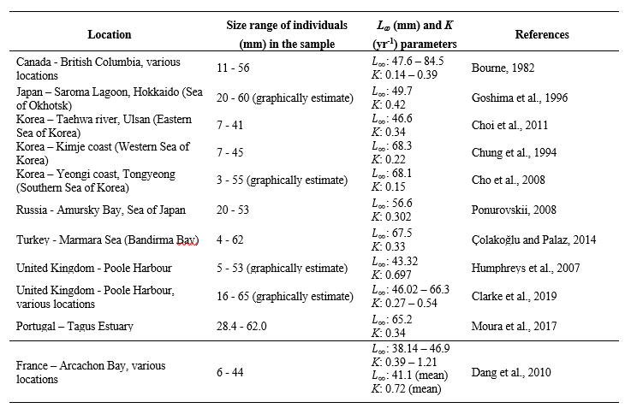
MCRS vs reproduction
MCRS vs others
Discussion/Conclusion
Context and issues
Regarding growth
Growth analysis dynamic along time
The L_∞ parameter is in a rather low range (L_∞ mean value = 41.1 mm) compared to the literature (Dang et al., 2010 and Table 2). At the bay scale, it was similar for the different hypsometric levels but differed between sites. It should be noted that L_∞ for Arcachon Bay is likely to be overestimated as some 40 mm clams were included in the enclosures at the beginning of the experiment (but did not grow). The experiment also showed a slow growth from about 30 mm (Dang, 2009).

