Slide 1
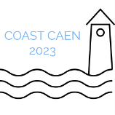

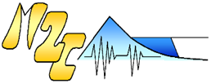
Investigating the dynamics of extreme wave energy transfer
during propagation towards coastal zones
Reine MATAR
Nizar ABCHA, Imen TURKI, and Nicolas LECOQ
UNICAEN | Université de Caen Normandie
UMR CNRS 6143 "Morphodynamique Continentale et Côtière"
reine.matar@unicaen.fr
24-27th of October 2023 Coast Caen

Slide 2
GENERAL PLAN
Introduction
Literature Review
Objectives
Materials and methods
Results and discussion
Conclusion
Future directions
Q&A

Slide 3
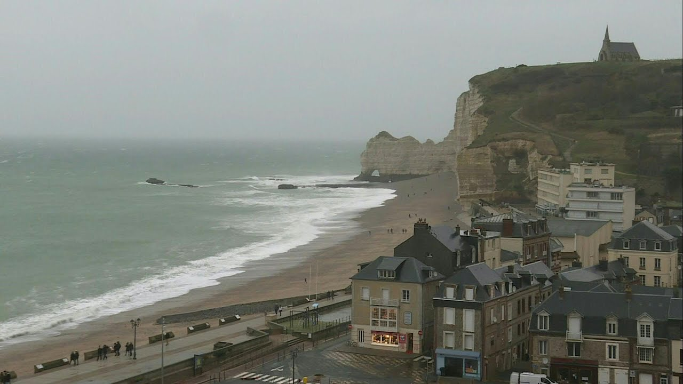
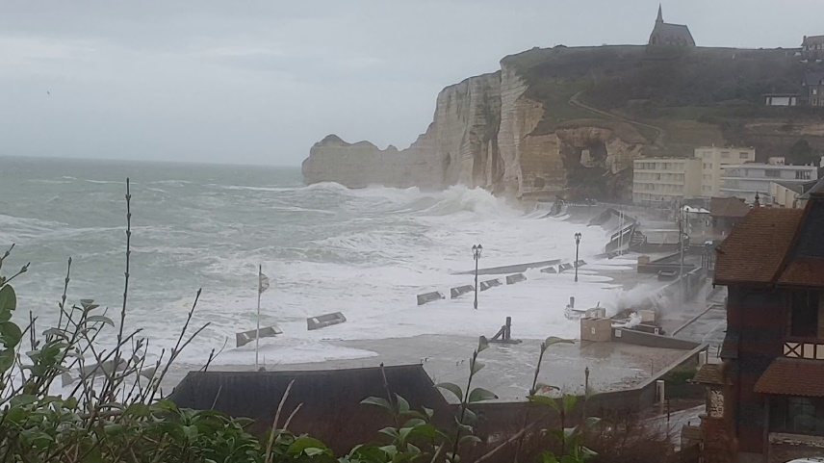
Introduction
The Normandy coastline experiences severe hydrodynamic conditions, including powerful tidal currents, intense waves, and strong turbulence.
On February 8, 2020, storm Ciara recorded a swell height greater than 4 m Causing a significant marine submersion of Etretat beach and that of Hautôt-sur-mer.
storm Ciara Etretat - Bing images

Slide 4
Research Landscape and Literature Gap
Studying the impact of extreme storm events on the hydro-morphodynamics in the coastal zone by physical modeling through wave flume experimentation.
    Gaps in the existing literature:
      Lack of Autobicoherence Analysis in Coastal Dynamics
      Limited Understanding of Energy Dissipation Mechanisms
      Incomplete Frequency Interaction Analysis
      Limited Application of Wavelet Transform in Coastal Studies

Slide 5
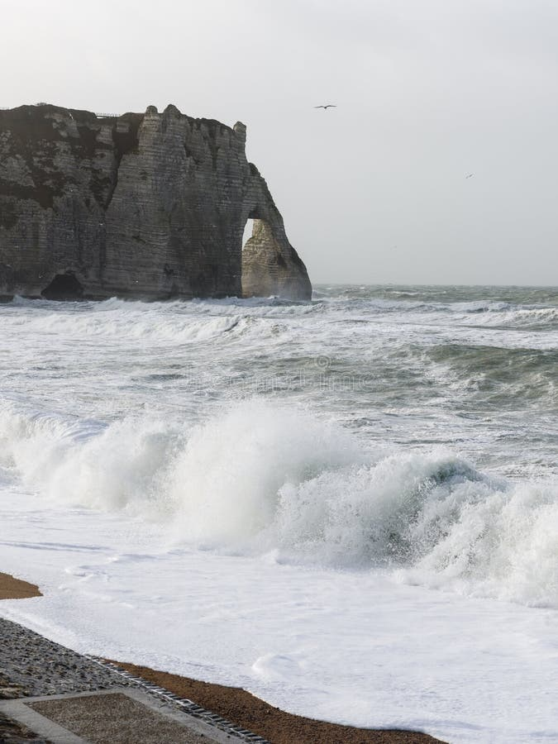
Literature Review
Extreme events can be generated by many ways :
  Sudden variation in bathymetry
  Modulational instability (for kh > 1.36)
  Collision between two soliton
  Focused waves
Cavaleri et al. 2012
Benjamin et al., 1967
Marin, F. et al., 2005 a, b.
Kharif et al., 2009
Touboul et al., 2015
vague extreme Etretat - Bing images

Slide 6
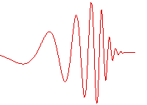
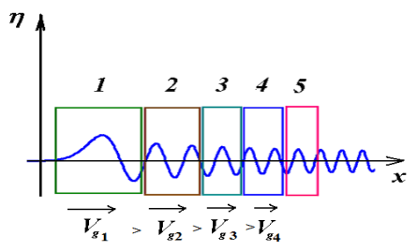
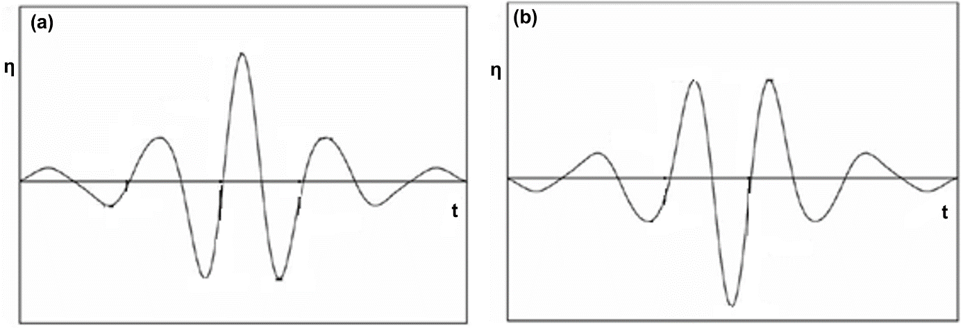

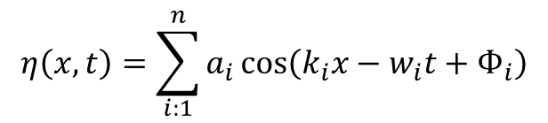
  Focused waves
$$η\left(x,t\right)=\sum_{i:1}^{n}{a_{i}}cos\left(k_{i}x−w_{i}t+Ф_{i}\right)$$
$Ф_{i}=0 Ф_{i}$= π

Slide 7
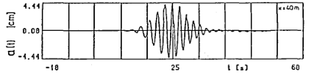
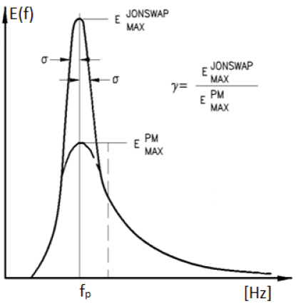
  Wave train spectra
Gaussian
Pierson-Moskowitz
JONSWAP (γ=3.3)
JONSWAP (γ=7)
Gaussian envelope of a wave train (Günther. 1986.)
Spectra of Pierson-Moskowitz and JONSWAP
γ : correction factor

Slide 8
Objectives
Uncover the hidden dynamics of coastal waves through advanced analysis techniques.
      Introduce autobicoherence analysis to coastal dynamics research.
      Investigate energy dissipation mechanisms during wave propagation.
      Explore nonlinear frequency interactions often overlooked.
      Utilize wavelet transform for identifying frequency components.

Slide 9
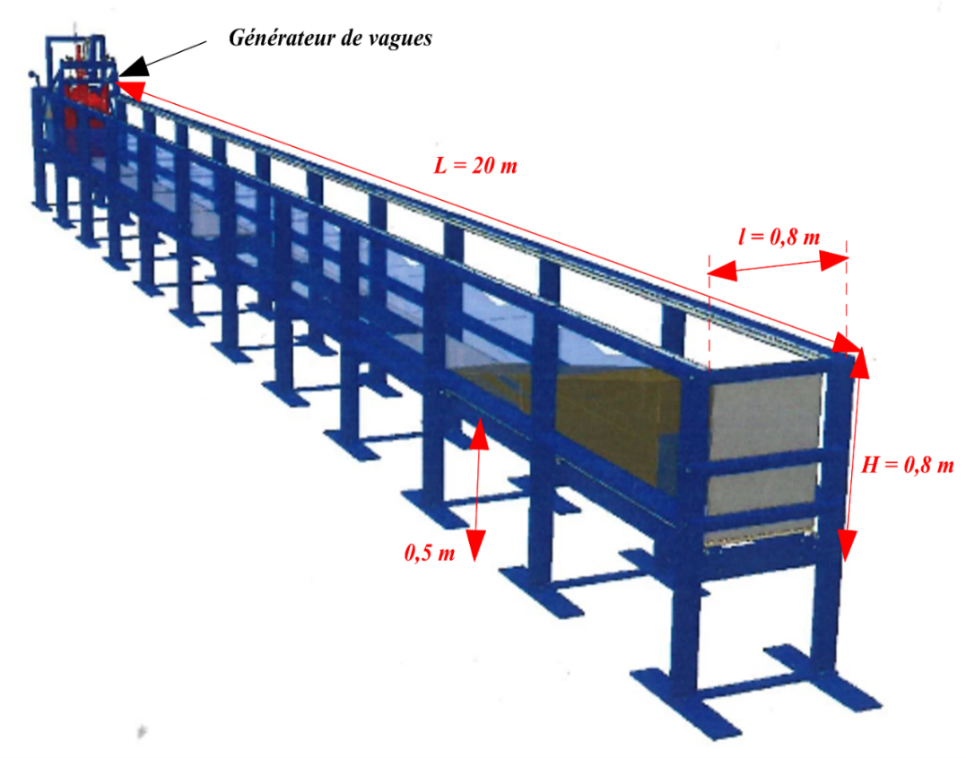
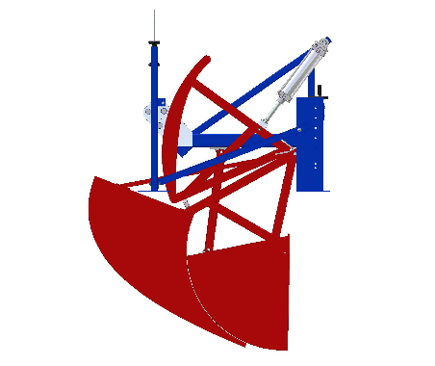
Materials and methods
Wave flume
Wave Generator
L x l = 20 m x 0.8m
Inclined PVC beach β = 1/25
Water level h₀ = 0.3 m
Peak frequency = 0.75 Hz
9 wave amplitudes
Wave breaking at 12m from generator
4 spectra: Gaussian, Pierson-Moskowitz
JONSWAP (γ = 3,3) et JONSWAP (γ = 7)
Wave flume (done using Autocad by Sylvain Haquin)
Wave generator (done using Autocad by Sylvain Haquin)

Slide 10
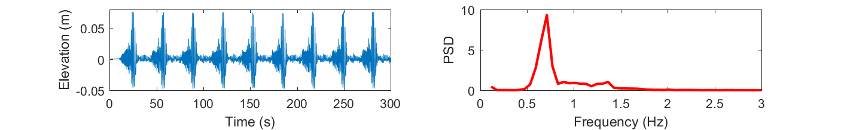
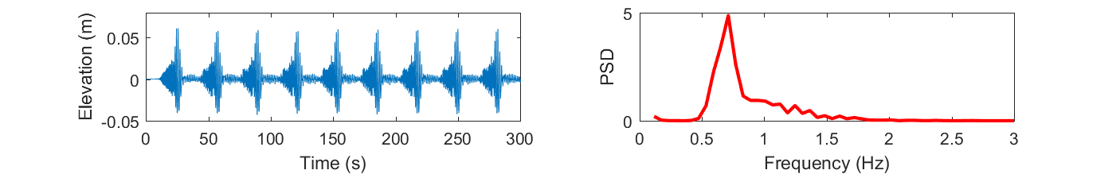
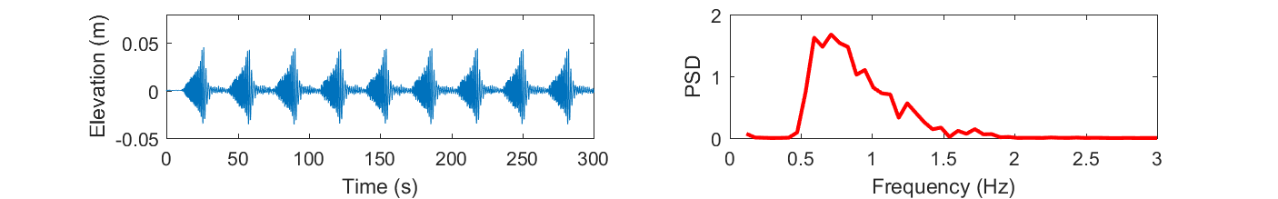
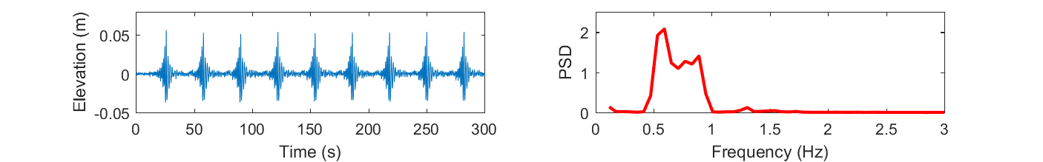
Wave Spectra used
Spectrum
Jonswap (γ = 7)
Spectrum
Jonswap (γ = 3.3)
Spectrum
Pierson Moskowitz (γ = 1)
Spectrum
Gaussian
Free surface elevation (m) versus time (s)
Power spectral density versus frequency (Hz)

Slide 11
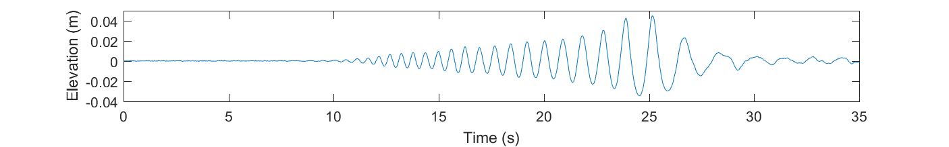
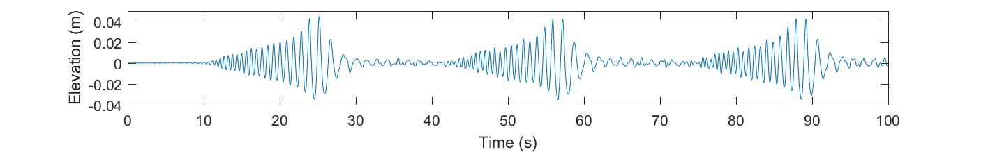
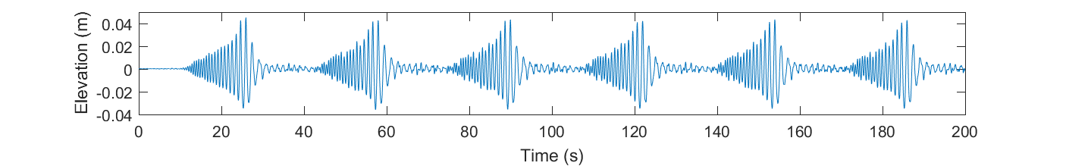
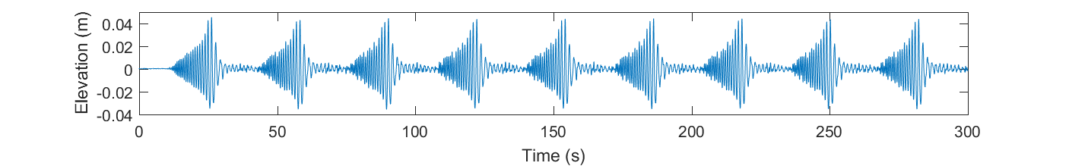
Wave train number used
Number
1 wave train
Number
3 wave train
Number
6 wave trains
Number
9 wave trains
Free surface elevation (m) versus time (s)

Slide 12
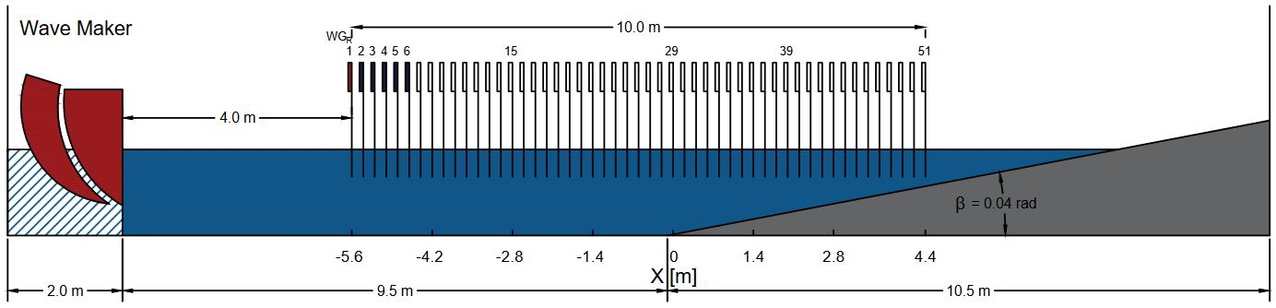
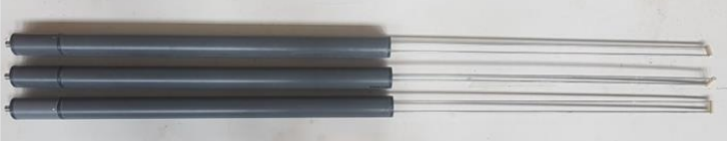
Wave Gauges positions
51 Positions :
  WG1 4m (reference)
  Packet of 5 WG (x10)
Wave Gauges
Reference
signal
Toe of slope
Wave breaking
Sketch of the wave flume. The direction of propagation: from left to right

Slide 13

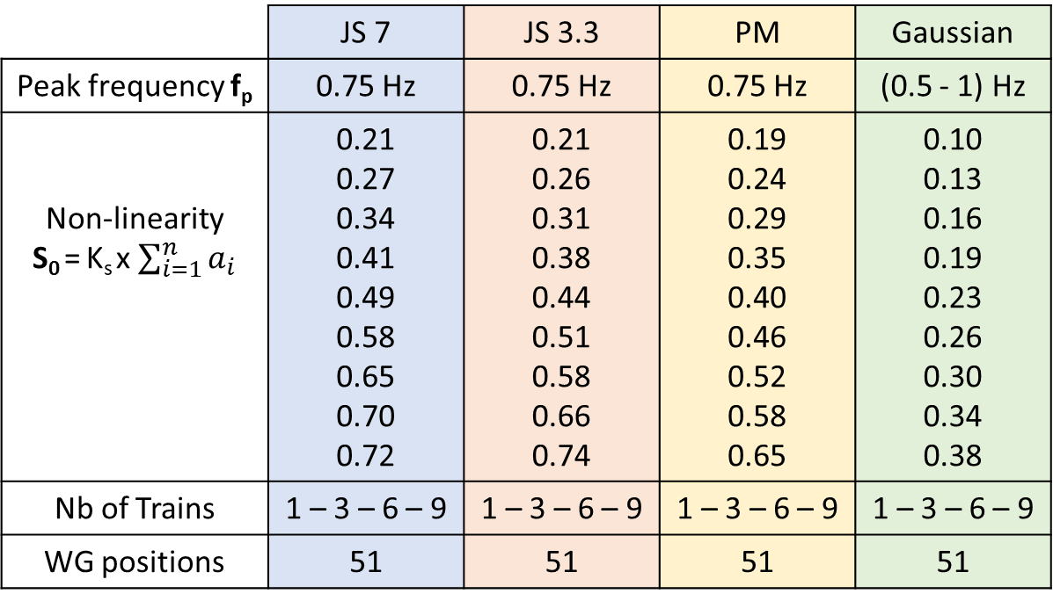
Experiments summary
 | JS 7 | JS 3.3 | PM | Gaussian
Peak frequency f_{p} | 0.75 Hz | 0.75 Hz | 0.75 Hz | (0.5 - 1) Hz
Non-linearity S₀ = K_{s} x $\sum_{i=1}^{n}{a_{i}}$ | 0.21 0.27 0.34 0.41 0.49 0.58 0.65 0.70 0.72 | 0.21 0.26 0.31 0.38 0.44 0.51 0.58 0.66 0.74 | 0.19 0.24 0.29 0.35 0.40 0.46 0.52 0.58 0.65 | 0.10 0.13 0.16 0.19 0.23 0.26 0.30 0.34 0.38
Nb of Trains | 1 – 3 – 6 – 9 | 1 – 3 – 6 – 9 | 1 – 3 – 6 – 9 | 1 – 3 – 6 – 9
WG positions | 51 | 51 | 51 | 51
Flume experiments
1350 signals
Dispersion relationship
(2𝜋𝑓_{s})² = g 𝑘_{s} tanh (𝑘_{s}ℎ₀)
K_{s} : Characteristic wavenumber
f_{s} : Characteristic frequency

Slide 14
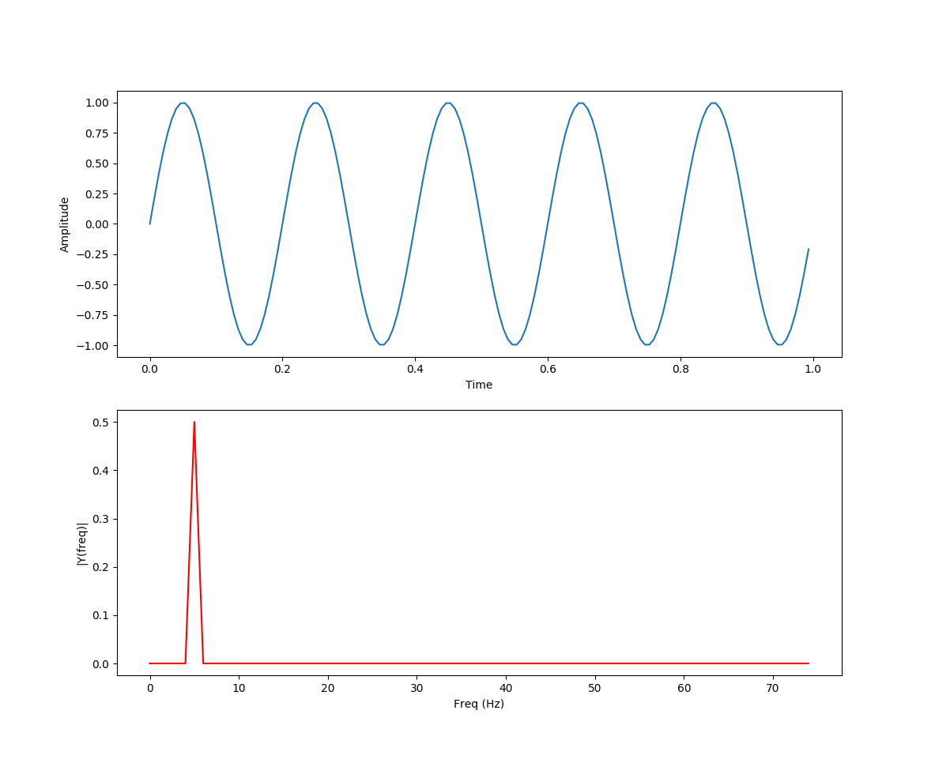
Processing techniques
 | Linear theory | Non-linear theory
Frequencies Interaction | No | Yes
Analysis | Spectral : FFT | Bi-spectral : Bi-coherence
Mother wavelet : Morlet
b²(f₁,f₂) for a frequency triplet (f₁, f₂ et f₁ + f₂)
0: Non-existent interaction
1: Maximum interaction
Sinus FFT - Bing images

Slide 15
Results and discussions
51 Positions :
  WG1 4m (reference)
  Packet of 5 WG (x10)
Reference
signal
Toe of slope
Wave breaking
Sketch of the wave flume. The direction of propagation: from left to right

Slide 16
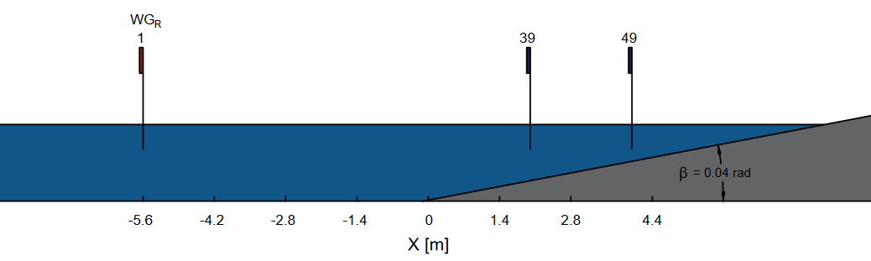
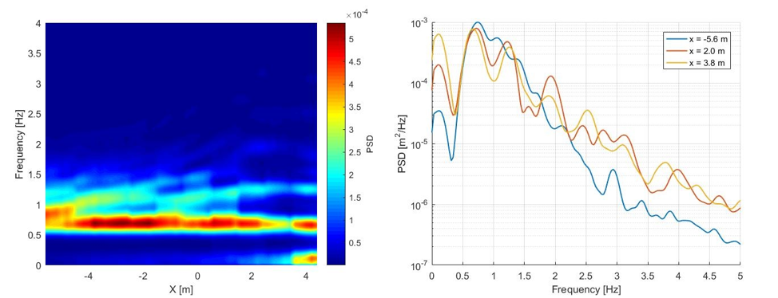
Power Spectral Density
(a)
(b)
Experimental Pierson-Moskowitz spectrum in different scales: (a) Spatial evolution of the spectrum; and (b) Spectra of three positions.

Slide 17
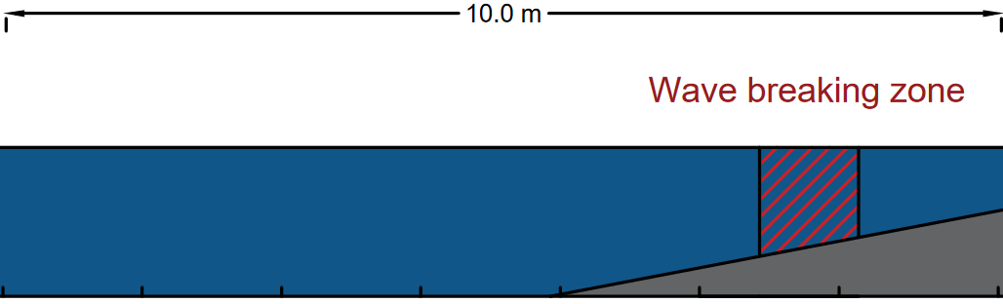
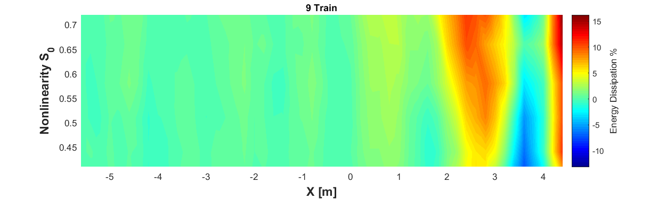
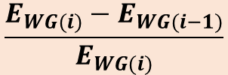
Wave Energy differential:
$$\frac{E_{WG(i)}−E_{WG(i−1)}}{E_{WG(i)}}$$
Energy dissipation percentage using a Jonswap (γ =3.3) spectrum for multiple nonlinearities.

Slide 18
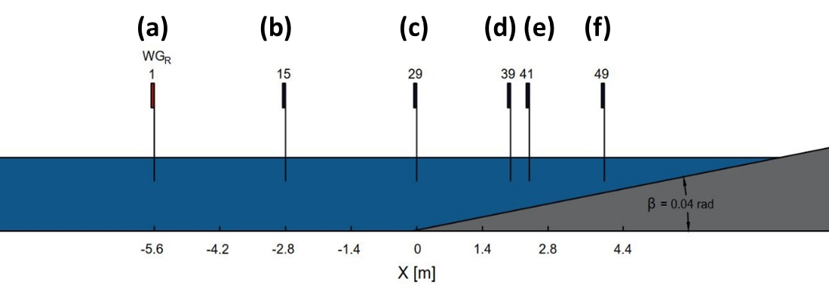
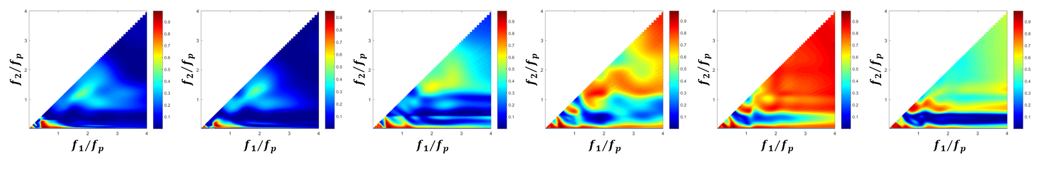
Auto-bicoherence
(a)
(b)
(c)
(d)
(e)
(f)
Spatial evolution of auto-bicoherence for 6 different sections along the canal.
(a): x = -5.6m (h = 0.3 m), (b): x = -2.8 m (h = 0.3 m), (c): x = 0 m (h = 0.3 m), (d) : x = 2 m (h = 0.24 m), (e) : x = 2.4 m (h = 0.2 m), (f) : x = 4 m (h = 0.12 m)

Slide 19
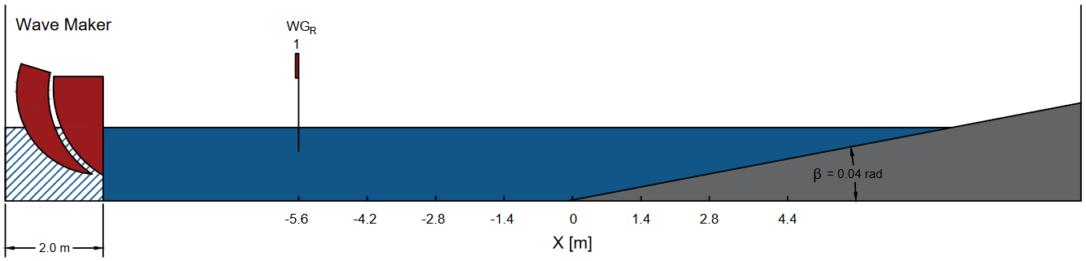
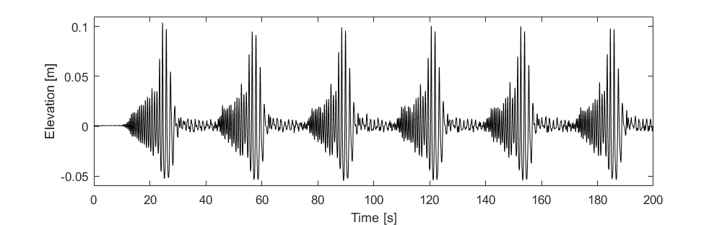
Frequency components (MODWT)
Sketch of the wave flume. The first wave gauge is indicated (-5.6m)
Free surface elevation (m) of the reference signal versus time (s)

Slide 20
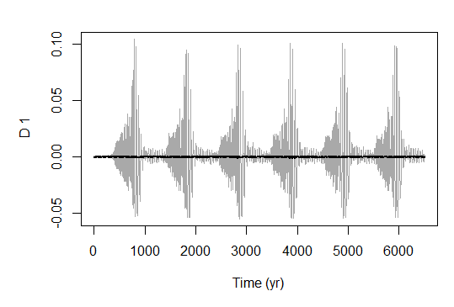
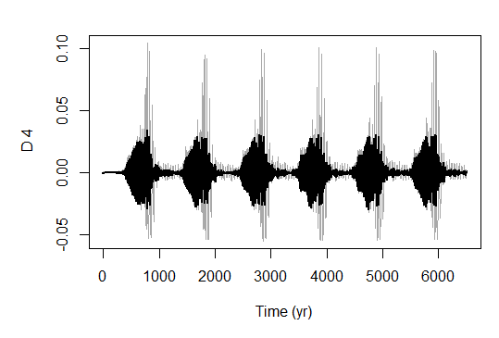


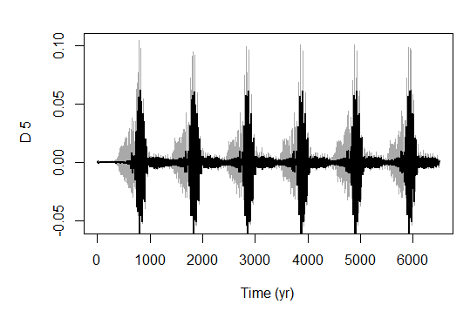

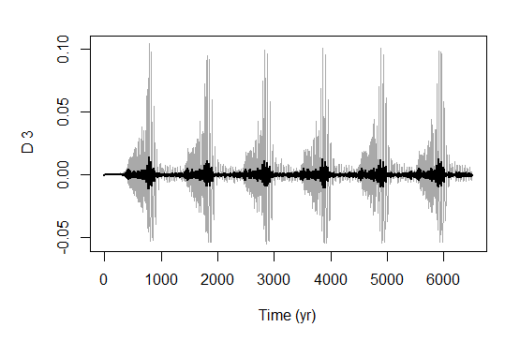


  Components signals (Initial position)
Data points
Data points
Data points

Slide 21

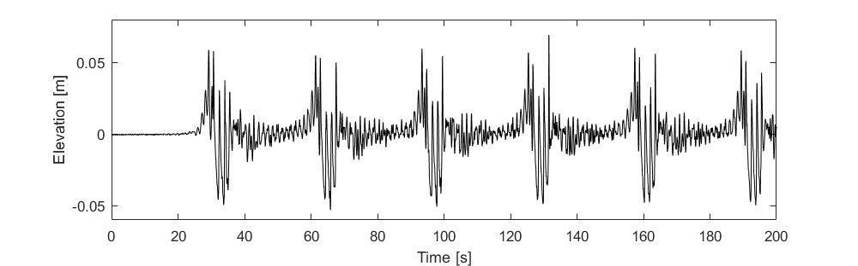
Sketch of the wave flume. The last wave gauge is indicated (4.4m)
Free surface elevation (m) of the final signal versus time (s)

Slide 22
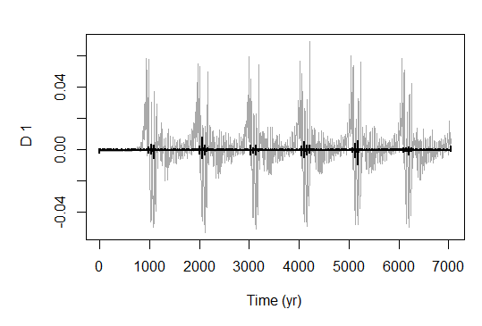
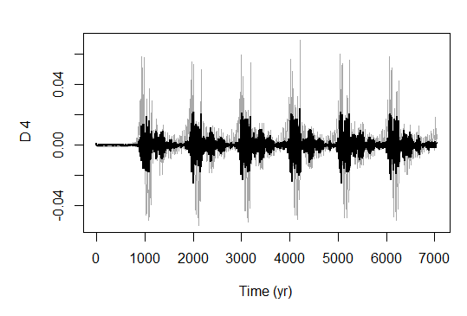
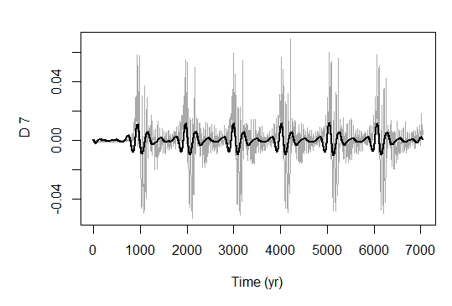
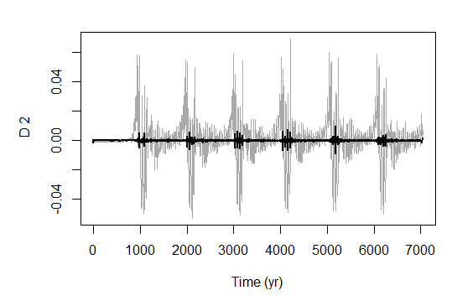
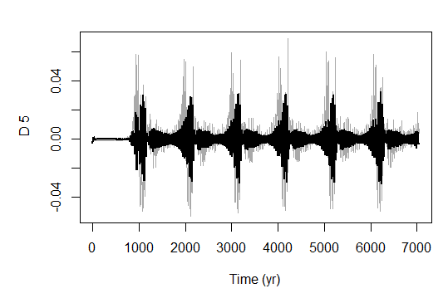
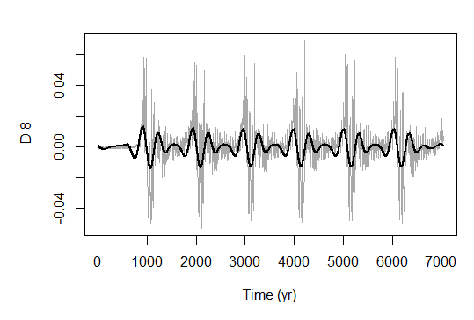
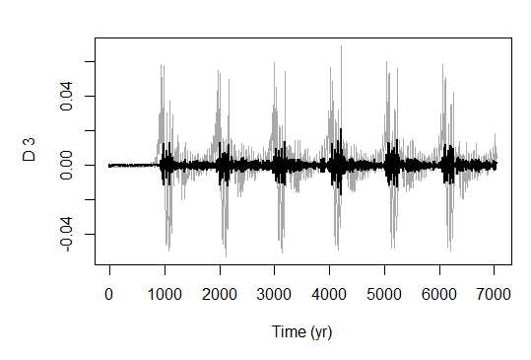
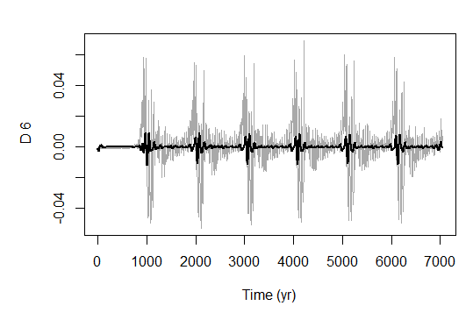
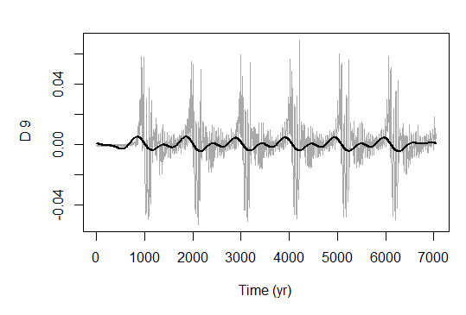
  Components signals (Final position)
Data points
Data points
Data points

Slide 23
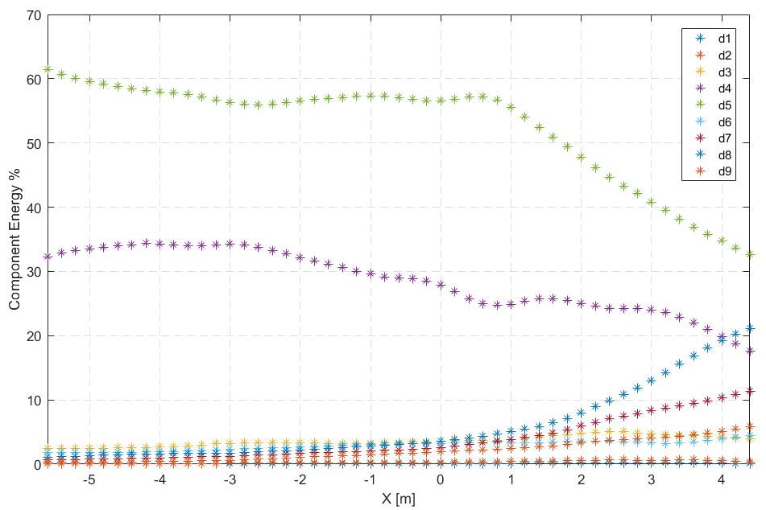
Frequency components
  Energy
Spectrum: JS3.3 S₀ = 0.74 Nb of Trains = 6
d5
d4
d8
Frequency components energy versus WG positions (m)

Slide 24
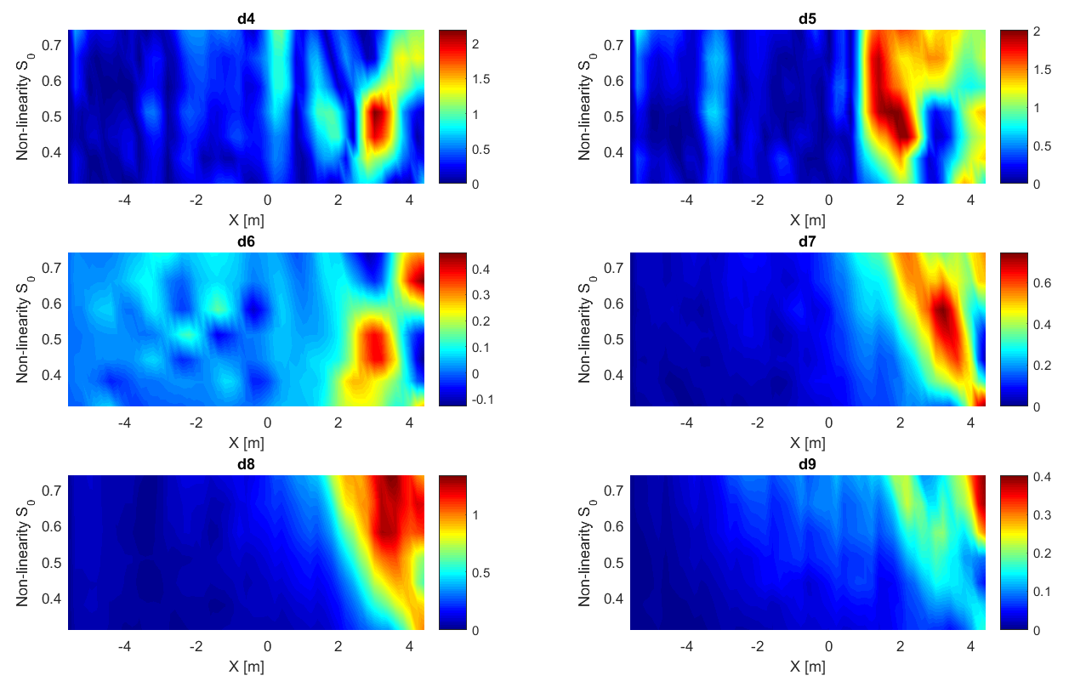
Frequency components
  Energy differential ($E_{WG(i)}−E_{WG(i−1)}$)
Wave breaking
Wave breaking
Frequency components energy differential versus WG positions (m)

Slide 25
Conclusion
Our work is a stepping stone toward safeguarding coastal regions in the face of evolving challenges.
  Autobicoherence analysis unveiled intricate frequency interactions in coastal waves, suggesting a connection between these interactions and energy dissipation.
  Our exploration expanded with wavelet analysis, linking energy dissipation to specific frequency components.

Slide 26



Future Directions
Wave statistics
Numerical modeling
Sediment Transport
PDF
Skewnes
Kurtosis
And higher order moments
Xbeach
Simulation of in situ data
Flume experiments
+ sediments
mPeregrine
Boussinesq equations
Digital Twin, Machine Learning
Results confirmation

Slide 27
THANK YOU FOR YOUR ATTENTION
QUESTIONS ?

Slide 28

(a)
(b)
(c)
(d)
(e)
(f)

Slide 29

Wavelet transform
  Frequency components evolution

Slide 30


Machine Learning
  Predicting frequency components energy
d5
d8

Slide 31


Machine Learning
  Predicting Skewness and kurtosis
Skewness
Kurtosis

